Slide 1
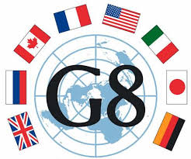
G-8 Summit 2016
By: Roma-Lyon Analysts
Simulation Group C

Slide 2
Plot Overview
Who: A Group of Worldwide Terrorists responding to Zawahiri's call. Leader of operation is “Morsheete”
What: A dirty bomb with crowd control munitions, shotguns, and suicide bombs
When: April 2nd, 2016
Where: Capitol Building, Washington D.C.

Slide 3
Social Network Analysis

Slide 4
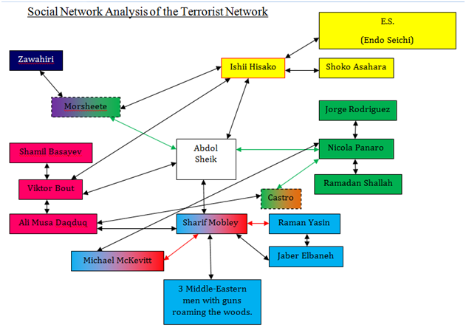
Abdol

Slide 5
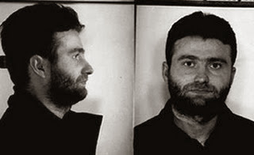
Nicola Panaro
Nicola Panaro was born on September 12, 1968 in Casal di Principe, Italy.
Member of the Caselesi clan of the Camorra, an Italian organized crime group.
Wanted for murder, racketeering, Mafia association, and drug trafficking.
Leader of the finance cell of “The Festival.”

Slide 6
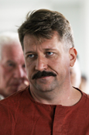
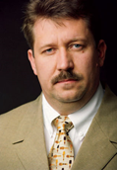
Viktor Bout
Born in Dushanbe, Tajikistan on January 13, 1967.
Bout is a suspected arms dealer who owns a number of shipping companies.
Leader of the weapons smuggling cell of “The Festival.”
Suspected of helping in the transport of radioactive material into the United States.

Slide 7
Hisako Ishii
Born in 1960.
Has three children with the founder of Aum Shinrikyo (Shoko Asahara).
Ishii served for a time as Aum Shinrikyo's "minister of finance."
Leader of the weapons procurement cell of “The Festival.”

Slide 8
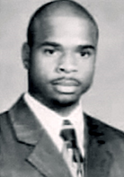
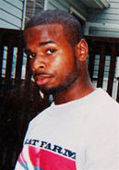
Sharif Mobley
Born in Buena, New Jersey in 1984 and grew up in southern New Jersey.
Only major player in “The Festival” who is American born.
Likely leading some sort of domestic strike force.
Mobley is believed to be a supporter of the radical islamist group, al-Shabab.
Leader of the strike team cell and a member of the recruitment cell of “The Festival.”

Slide 9
The Gatekeeper
Alias: “Haseeb Abdol Sheik.”
Gatekeeper of “The Festival.”
Major coordinator of “The Festival’s” activities.
Direct connections with all aforementioned players.
Only operative in “The Festival” with direct ties to “Morsheete.”

Slide 10
When and Where

Slide 11
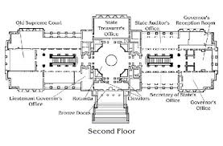
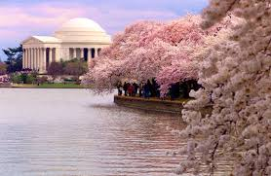
The Target
U.S Capitol Building is the main target
Secondary target is the United Nations Building in New York City - this target will not be attacked in this plot
The attack will begin on April 2, 2016 which is the first day that Congress will be back in session.

Slide 12
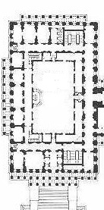
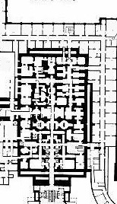
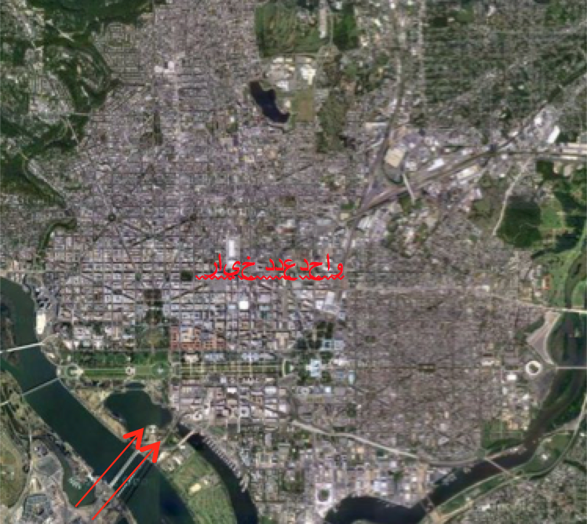
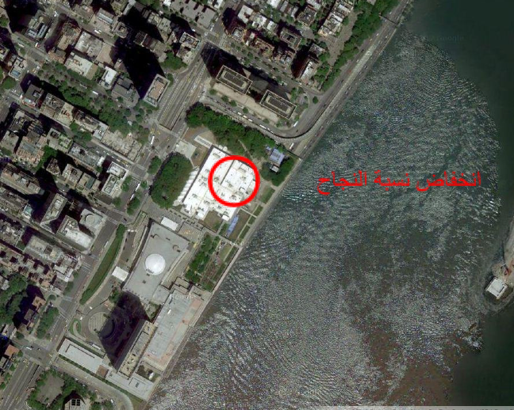
Evidence for this conclusion
House of Reps | Senate basement

Slide 13
Timeline of Major Events

Slide 14
Initial Developments
Some unidentified person asked another unidentified person if he could “find a capable and energetic brothers with many connections and the courage, skill and will to do what must be done.”
He will also organize the big festival
Contact with Michael McKevitt for the recruitment of “soldiers” for the plot
Development of Victor Bout and Basayev with the whereabouts of the “sons” (bombs)

Slide 15
Development with gathering of weapons
Military transport vehicle was taken at gunpoint
Men asked to use the radio cause they, so called did not have cellular phones
They incapacitated the driver and held everyone else at gunpoint
Hijackers were driving a non-descript rental car
Transport had c-4 plastic explosives along with long-range-anti-personnel weapons and crowd control munitions
Stolen Plumbing Van in Florida
Found a car pulled over and vehicle was found to be empty, the Van number was searched and found to be for Yasin, several blueprints and maps were found, critical info was crossed out
Tire marks from a van is seen in an abandoned warehouse in Germany
Meetings between Ishii and Endo
Stolen supplies from the University of Tokyo

Slide 16
Men and supplies making it to the U.S.
Panaro calls unidentified Male asking if he could get a package to the State
The package will not need any air. (this rules out human trafficking)
Men were able to skip Immigration and customs Formalities landing in Cuba from a private aircraft
Submersible vehicle found on the coast of Florida
Meeting between the multiple nodes of the plot
This meeting took place at “The school of the inventor of lights”

Slide 17
Weapons

Slide 18
Radiological WMD
Made by Shamil Basayev, detonated outside the capitol building
Viktor Bout in charge of obtaining WMD alias: “youngest son”
Transported using a van lined with lead paneling to avoid detection
Would contaminate for years, validating Zawahiri's call

Slide 19
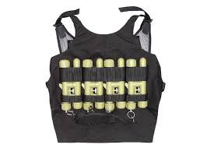
Martyrs
Recruited by Sharif Mobley and Michael McKevitt
Armed with suicide vests, sawed off shotguns, and crowd control munitions
At least 8 Indonesian Men, transported through Cuba
Practiced in Huntley Meadows Park, Alexandria VA

Slide 20
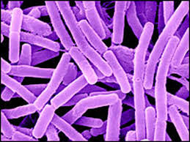
Biological WMD
Plan two- aborted because of time constraints
Anthrax- stolen from Tokyo University of Science
Ishii Hisako initiated phase one of the WMD but Seiichi Endo assisted with phase two

Slide 21
Transportation

Slide 22
Transportation
October 10th
-Victor Bout communicates about acquiring a gift
October 30th
-Sharif Mobley is seen headed to the United States
December 13th
-Bout communicates more about the weapons transport
January 17th
-Victor Bout Travels with weapon to Lebanon to meet Daqduq, Venezuela

Slide 23
Transportation
February
-Transport Vans
-Unidentified plane lands along with Indonesians
-Submersible discovered
March 2nd
-Van Found in upstate NY registered stolen from Key Largo Florida
-Quite Possibly how the weapon arrived

Slide 24
Funding

Slide 25
Funding
Who is contributing?
Nicola Panaro - Contributed majority of contributions (contributed > $1 Million)
“Italy made it much further in the Cup than anyone anticipated.” (Unknown Male)
France - French sympathizer who (Pledged Approx $600,000)
$315,000 between international accounts #818849762632 to #182837207273
Where is the money going?
Global Relief Foundation
Closed money laundering organization
Bank accounts still active

Slide 26
False Leads

Slide 27
False Leads
-A Japanese report dated 2/12/2012 where Hisako Ishii meets Seiichi Endo in Tokyo takes place well before anything related to “The Grand Festival” plot.
- Ishii was unable to obtain weaponized anthrax in time for the attacks, ultimately making her and her cell’s involvement in the plot insignificant.
- Internet search history from the computer seized by German Intelligence on October 25, 2015 showed searches for events in New York City (among relevant items). New York City (specifically the UN Building) was originally chosen as a secondary target and is not going to be attacked as a part of “The Grand Festival”.
- Early theory of a “Decapitating Strike” based on the 9/30/2015 September Canadian Report.

Slide 28
Questions?

