Slide 1
Intrusion Detection System
SRA 221
Team 8
Natalie Wagner, Allen Fidler, Chalsey Dorce, Cesar Colchado
Notes:
Allen

Slide 2
Our Company & Our Client
To simulate implementing our IDS in a real life situation, we decided to create a client
We have been hired by the pharmaceutical company Merck
Merck has experience problems with hackers getting into their system and stealing their information
We have done an evaluation on their system, assessed their problems, and decided that they need an efficient Intrusion Detection System
Notes:
Allen

Slide 3
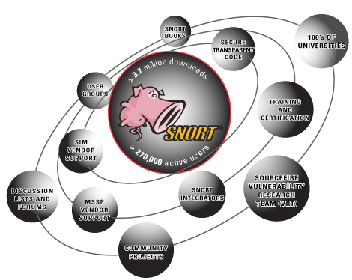
Our Solution
We believe the best solution for Merck’s problem is to enhance their security by using the Intrusion Detection System, Snort
We will implement the rules we find necessary for their specific company needs
Snort offers various flexible modes which we will teach the company and prepare them for future intrusions
Notes:
Allen

Slide 4
Benefits
Snort is open source and FREE to implement into a network
Widely used, worldwide community, frequent improvements and updates
Can be configured by employees with customized rules
Implementing only the rules the client wants.
Simplicity
User friendly and with hundred of online forums for help
Notes:
Allen

Slide 5
How We Did it
Downloaded virtual machine called VirtualBox
Within the VirtualBox, we used Ubuntu
Downloaded and configured Snort on victim’s machine
Downloaded and configured Wireshark to view the logs
Started a separate virtual machine for the attacker machine
Located the rules file on the victim machine and added our rules
To simulate an attack and display the rules, we used the FTP command
Notes:
Chalsey

Slide 6
Types of Rules Implemented
For our specific client, we implemented the following rules:
Alert
Log
Reject
Although there are many different rules that can be implemented into an IDS using Snort, we felt that these rules would be most beneficial for our client
Notes:
Chalsey

Slide 7
New Rule: Alert
alert tcp any any -> $HOME_NET any (msg”tcp alert test”; sid: 1000001: rev:001;)
Generates an alert using the selected alert method, and then log the packet
Notes:
Chalsey

Slide 8
Alert Video
Notes:
Chalsey

Slide 9
New Rule: Log
Log tcp any any -> $HOME_NET 1:1024
Logs the packet
Notes:
Cesar
1:1024 is a range of ports that the rule tells snort to monitor.

Slide 10
Log Video
Notes:
Cesar

Slide 11
New Rule: Reject
reject tcp any any -> $HOME_NET any (sid:1000006; rev:001;)
Blocks the packet, logs it, and then sends a TCP reset if the protocol is TCP or sends an ICMP port unreachable message if the protocol is UDP.
Notes:
Cesar
In this case this rule tells snort to look for packets coming from any IP address using any ports going to the victim’s IP address.

Slide 12
Reject Video
Notes:
Cesar

Slide 13
Additional Rules:
We did not use the following rules in our project, but here’s a few examples of other rules that could be implemented into and IDS using snort:
Activate - alerts and then turns on another dynamic rule
Dynamic - remains idle until activated by an activate rule, then acts as a log rule
Pass - ignores the packets
Drop - blocks and logs the packets
Sdrop - blocks the packets but does not log them
Notes:
Natalie

Slide 14
Challenges We Faced Creating Our IDS
We struggled getting different IP addresses on our 2 virtual machines
We fixed this by making a second host-only adapter in each machine through the network settings
Configuring Snort on the virtual machine
We found a step by step tutorial online that walked us through the process
We originally planned to use the Activate/Dynamic rule but we found that it was outdated.
We decided to implement different rules that would work better for our system
Notes:
Natalie

Slide 15
Works Cited
"Creating SNORT Rules." YouTube. YouTube, 25 June 2014. Web. 19 Apr. 2017.
Jim McIntyre | August 22, 2001, 12:00 AM PST. "Using Snort for intrusion detection." TechRepublic. N.p., n.d. Web. 19 Apr. 2017.
Maier, Christopher. "Christopher Maier." Christopher Maier's Technical Blog. N.p., 01 Sept. 2010. Web. 19 Apr. 2017.
Photos:
https://www.google.com/search?q=Merck+pharmaceutical&espv=2&source=lnms&tbm=isch&sa=X&ved=0ahUKEwign-LLorHTAhUI12MKHc4zAJgQ_AUICCgD&biw=1920&bih=974#imgrc=_v7sGUY1JN5xDM:
https://www.google.com/search?q=Merck+pharmaceutical&espv=2&source=lnms&tbm=isch&sa=X&ved=0ahUKEwign-LLorHTAhUI12MKHc4zAJgQ_AUICCgD&biw=1920&bih=974#tbm=isch&q=money+symbol&imgrc=b887B1mdpwyrWM:
http://blog.redborder.com/how-effective-is-snort-ids-in-todays-complex-environments
https://www.google.com/search?q=intrusion+detection+system+alert&espv=2&source=lnms&tbm=isch&sa=X&ved=0ahUKEwiCuoi2o7HTAhVhyoMKHdT6C5QQ_AUIBigB&biw=1920&bih=974#imgrc=zQLF_gKvJE0vHM:
https://www.google.com/search?q=cartoon+wooden+log&espv=2&source=lnms&tbm=isch&sa=X&ved=0ahUKEwj-kJLYo7HTAhXLxYMKHcvABVQQ_AUIBigB&biw=1920&bih=974#imgrc=904GwHbmo3AlGM:
Notes:
Natalie

Slide 16
Questions?
Notes:
Natalie

